Slide 1
Introduction to Computing
Lecture 5: Computer Hardware & Operating System

Slide 2
Objective
After studying this chapter, the student should be able to:
Hardware
List the three subsystems of a computer.
Describe the role of the central processing unit (CPU) in a computer
Describe the main memory and its addressing space
Distinguish between main memory and cache memory
Define the input/output subsystem
Operating Systems
Understand the role of the operating system in a computer system
Give a definition of an operating system
Understand the process of bootstrapping to load the operating system into memory
List the components of an operating system

Slide 3
Computer Hardware
Notes:
Các hệ số

Slide 4
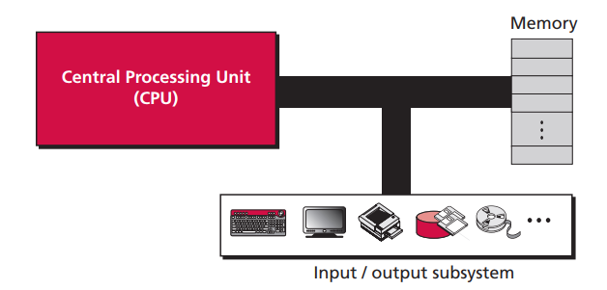
Computer Hardware
MAIN PARTS of COMPUTER
The parts that make up a computer into three broad categories or subsystems: the central processing unit (CPU), the main memory, and the input/output subsystem.
Notes:
Hệ đếm theo vị trí của ký số (Positional number system)

Slide 5
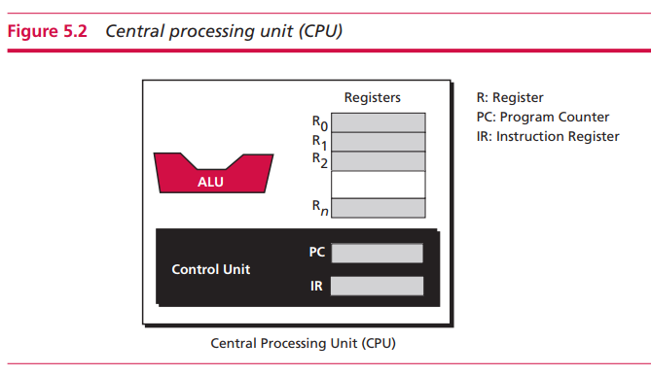
Central Processing Unit
The central processing unit (CPU) performs operations on data.
Three parts: an arithmetic logic unit (ALU), a control unit, and a set of registers

Slide 6
The arithmetic logic unit (ALU)
The arithmetic logic unit (ALU) performs logic, shift, and arithmetic operations on data.
Logic operations: NOT, AND, OR, and XOR. These operations treat the input data as bit patterns and the result of the operation is also a bit pattern.
Shift operations: Logical shift operations and arithmetic shift operations.
Logical shift operations are used to shift bit patterns to the left or right
Arithmetic operations are applied to integers
Their main purpose is to divide or multiply integers by two
Arithmetic operation
Some arithmetic operations on integers and reals

Slide 7
Registers
Registers are fast stand-alone storage locations that hold data temporarily. Multiple registers are needed to facilitate the operation of the CPU
Data registers: Computers use dozens of registers inside the CPU to speed up their operations. These require several registers to hold the intermediate results.
Instruction registers
Today computers store not only data, but also programs, in their memory.
The CPU is responsible for fetching instructions one by one from memory, storing them in the instruction register (IR), decoding them, and executing them.

Slide 8
Program counter
Another common register in the CPU is the program counter
The program counter keeps track of the instruction currently being executed.
After execution of the instruction, the counter is incremented to point to the address of the next instruction in memory.

Slide 9
Control Unit
The third part of any CPU is the control unit.
The control unit controls the operation of each subsystem.
Controlling is achieved through signals sent from the control unit to other subsystems

Slide 10
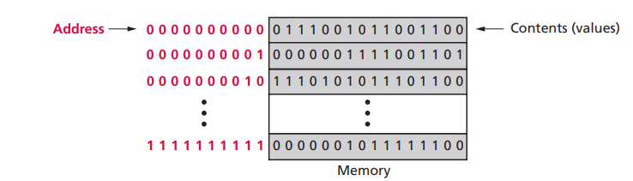
Main Memory
Main memory consists of a collection of storage locations, each with a unique identifier, called an address.
Data is transferred to and from memory in groups of bits called words.
A word can be a group of 8 bits, 16 bits, 32 bits, or 64 bits (and growing).
The word is 8 bits, it is referred to as a byte. The term ‘byte’ is so common in computer science that sometimes a 16-bit word is referred to as a 2-byte word, or a 32-bit word is referred to as a 4-byte word.

Slide 11
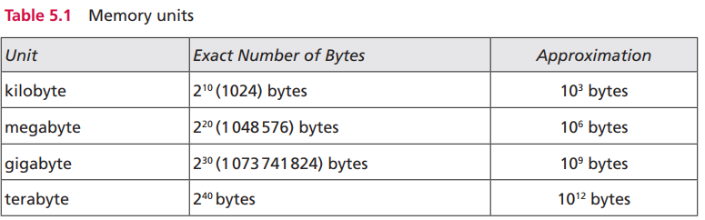
Address Space
To access a word in memory requires an identifier.
Although programmers use a name to identify a word (or a collection of words), at the hardware level each word is identified by an address.
The total number of uniquely identifiable locations in memory is called the address space.
For example, a memory with 64 kilobytes and a word size of 1 byte has an address space that ranges from 0 to 65535.

Slide 12
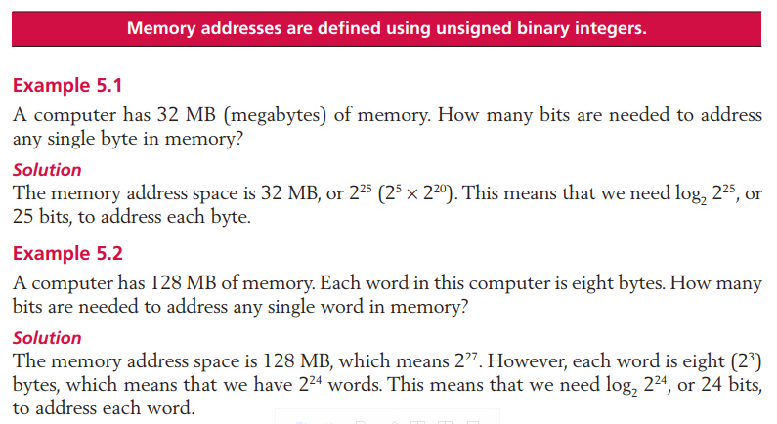
Examples

Slide 13
Memory Types: RAM and ROM
RAM: Random access memory (RAM) makes up most of the main memory in a computer.
A data item can be accessed randomly—using the address of the memory location—without the need to access all data items located before it.
All information in RAM is erased if you turn off the computer or if there is a power outage.
RAM technology is divided into two broad categories: SRAM and DRAM.
Static RAM (SRAM) technology uses traditional flip-flop gates to hold data. The gates hold their state (0 or 1), which means that data is stored as long as the power is on and there is no need to refresh memory locations. SRAM is fast but expensive.
Dynamic RAM (DRAM) technology uses capacitors, electrical devices that can store energy, for data storage. If a capacitor is charged, the state is 1; if it is discharged, the state is 0. Because a capacitor loses some of its charge with time, DRAM memory cells need to be refreshed periodically. DRAMs are slow but inexpensive.

Slide 14
ROM
The contents of read-only memory (ROM) are written by the manufacturer, and the CPU can read from, but not write to, ROM.
Contents are not lost if turn off the computer. It is used for programs or data that must not be erased or changed even if you turn off the computer.
PROM
One variation of ROM is programmable read-only memory (PROM). This type of memory is blank when the computer is shipped. The user of the computer, with some special equipment, can store programs on it.
When programs are stored, it behaves like ROM and cannot be overwritten. This allows a computer user to store specific programs in PROM
EPROM
A variation of PROM is erasable programmable read-only memory (EPROM). It can be programmed by the user, but can also be erased with a special device that applies ultraviolet light. To erase EPROM memory requires physical removal and reinstallation of the EPROM.
EEPROM
A variation of EPROM is electrically erasable programmable read-only memory (EEPROM). EEPROM can be programmed and erased using electronic impulses without being removed from the computer.

Slide 15
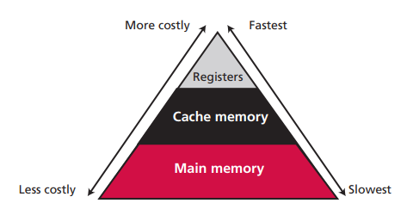
Memory Hierarchy
Computer users need a lot of memory, especially memory that is very fast and inexpensive.
This demand is not always possible to satisfy—very fast memory is usually not cheap
The solution is hierarchical levels of memory.
Use a very small amount of costly high-speed memory where speed is crucial. The registers inside the CPU are of this type.
Use a moderate amount of medium-speed memory to store data that is accessed often. Cache memory is of this type.
Use a large amount of low-speed memory for data that is accessed less often. Main memory is of this type

Slide 16
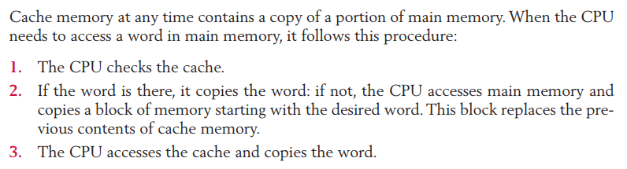
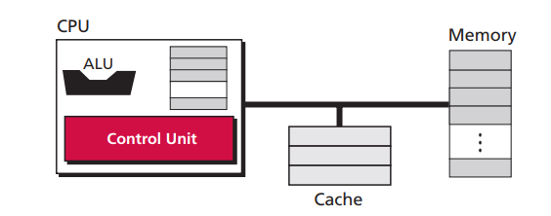
Cache Memory
Cache memory is faster than main memory but slower than the CPU and its registers.
Cache memory, which is normally small in size, is placed between the CPU and main memory

Slide 17
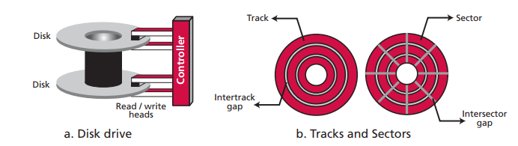
Input/Output Subsystem
Nonstorage devices
Nonstorage devices allow the CPU/memory to communicate with the outside world, but they cannot store information. Keyboard and monitor, printer
Storage devices
Storage devices can store large amounts of information to be retrieved at a later time. Their contents are not erased when the power is turned off.
Magnetic storage devices
Magnetic storage devices use magnetization to store bits of data. If a location is magnetized, it represents 1, if not magnetized, it represents 0.

Slide 18
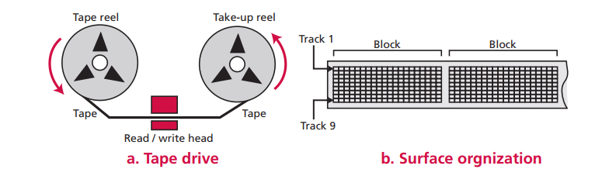
Magnetic Tape
Surface organization. The width of the tape is divided into nine tracks, each location on a track storing 1 bit of information. Nine vertical locations can store 8 bits of information related to a byte plus a bit for error detection.
Data access. A magnetic tape is considered a sequential access device. Although the surface may be divided into blocks, there is no addressing mechanism to access each block. To retrieve a specific block on the tape, we need to pass through all the previous blocks.
Performance. Although magnetic tape is slower than a magnetic disk, it is cheaper.
Today, people use magnetic tape to back up large amounts of data

Slide 19
Others
Optical storage devices
CD-R
CD-RW
DVD
…

Slide 20
Q & A

